Slide 1
Week 6
NX9523: Business Professional Practice
Notes:
1

Slide 2
Two Parts of the Assessment Portfolio
Part 1: Individual Reflective Report
60% of overall grade
1,500 words, plus appendices of evidence
Use a reflective model/theory
Keep notes to draw upon
Include academic references
Recognise and critique inquiry-based learning
Submit by TBC
Part 2: Team Presentation
40% of overall grade
10 minutes long
Recorded via Powerpoint
All team members submit same and receive same grade/feedback
Plus submit Consultancy Briefing Paper (or other document required by the Project Brief) – no more than 2 pages + appendices
Submit by TBC
Watch the Panopto Assessment Brief on Blackboard for more detail
Notes:
Team presentation, Briefing Note/report and appendices to be submitted via Blackboard – please see guidance in the Assessment folder
Submission time for both is 12:00
+/- 10% applies to both word count for the Individual Reflection and the timing of the Team Presentation i.e. the presentation can be a maximum of 11 minutes long and a minimum of 9 minutes long.
2

Slide 3
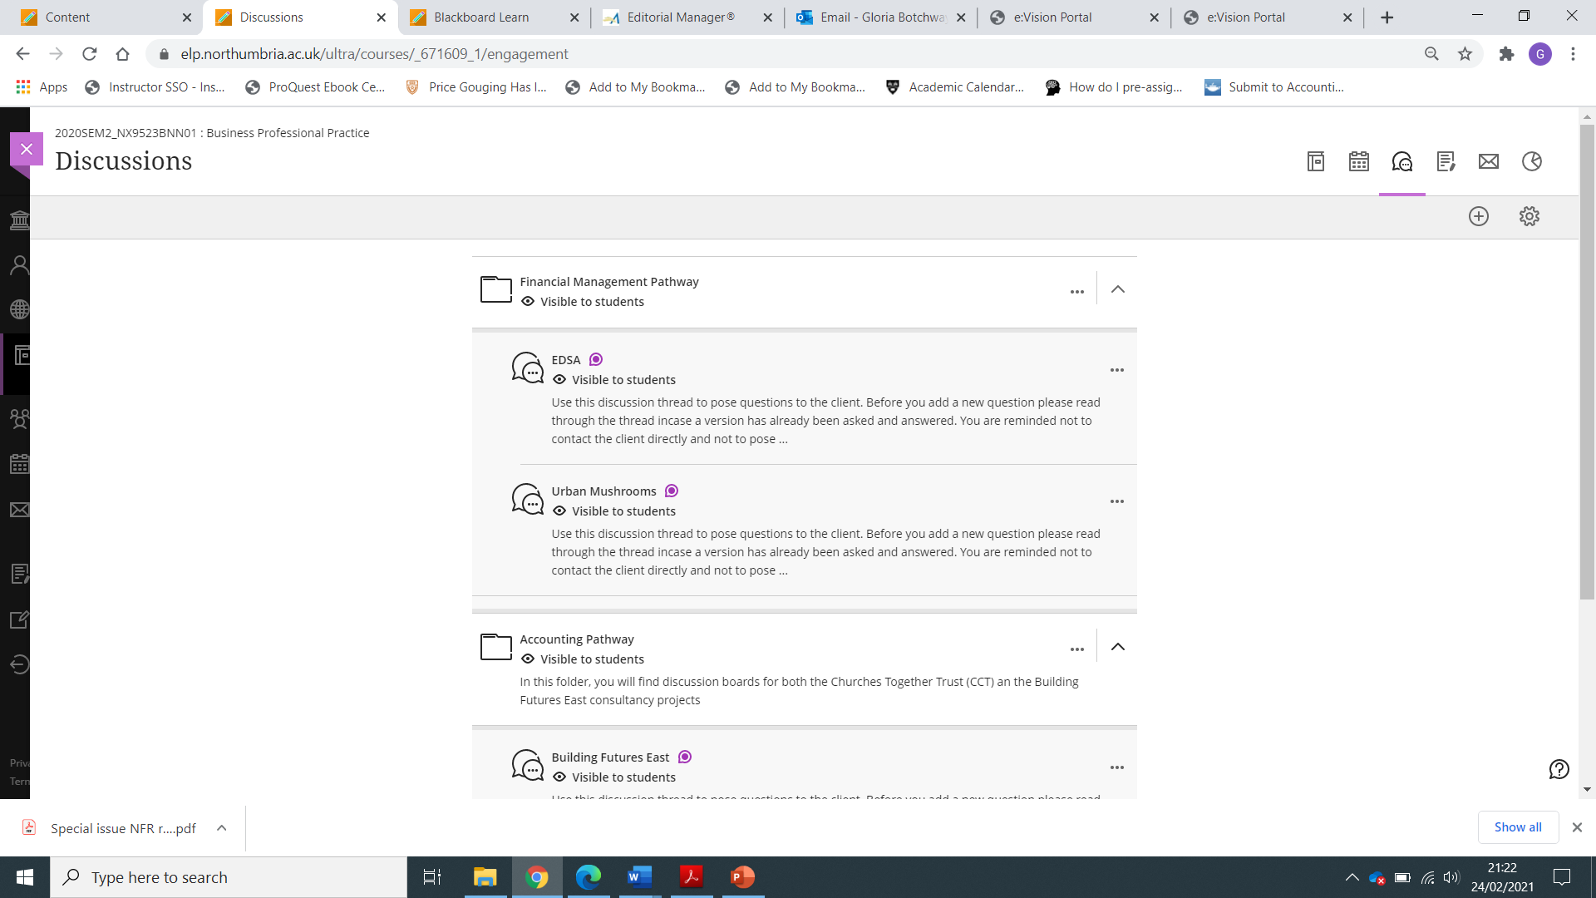
This Week
Team should have completed Team Ground Rules, Project Initiation Document and Gantt Chart
Continue researching the organization and the issues surrounding the Project Brief
Based on your research you may start to explore solutions
Consider what questions you might need to ask the client (only if you can’t find answer online)
Nb. Don’t contact the client directly, use the Discussion Board within your programme folder
Discussion boards will close in week 11
Consider whether any of the tools in the “Project and Consultancy Toolbox” folder on BB can help you
Notes:
3

